Slide 1

The Art of Post-Infection Response & Mitigation
What the hell just happened on my network?

Slide 2

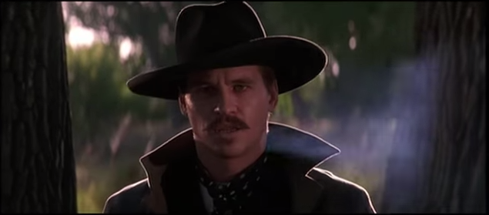
Who is this guy?
caleb (chill)
Sr. Malware Analyst @
Founder of the CarolinaCon Shootout
http://hackers.withguns.com
Dirty Whitehat
Your Huckleberry

Slide 3

Overview
Into the gray: a post-infection world
Malware breach response
Battle Planning
Dem toolz

Slide 4

Into the Gray
Why is post-infection kind of a gray area?
Overreliance on antivirus
Malware persistence techniques
Lack of exposure and training

Slide 5



Malware Breach Responses
Nuke and Pave
WTFFFFFFFFFF
Proper Response
Notes:
Lazy admin kung-fu is creating a secondary image of the machine before nuke and pave

Slide 6

Malware Breach Responses
Nuke and Pave
Re-image
+Quick Recovery
Lazy Admin Kung-Fu
WTF
Breach occurs
Denial ensues
FFFFFFFFFFFFUUUUUUUUUUUUUU!@#$!@#
Notes:
Lazy admin kung-fu is creating a secondary image of the machine before nuke and pave

Slide 7
Malware Breach Responses
Removal and Analysis
Obtain full, or individual process, memory dump(s)
30-60min packet capture
Manual malware extraction
Automated sandbox and/or manual analysis

Slide 8
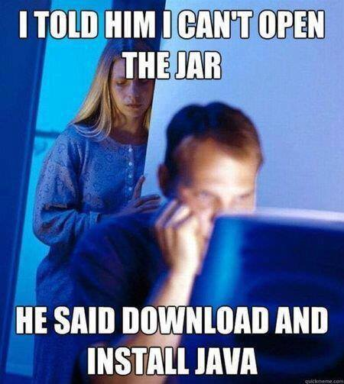
Battle Planning
Provide training to your people (or someone!)
Multiple response solutions
Network breach
Single node breach
False Positives
Multiple defense methods
Audit your damn network!
Do not install Java!
(unless you need it)

Slide 9
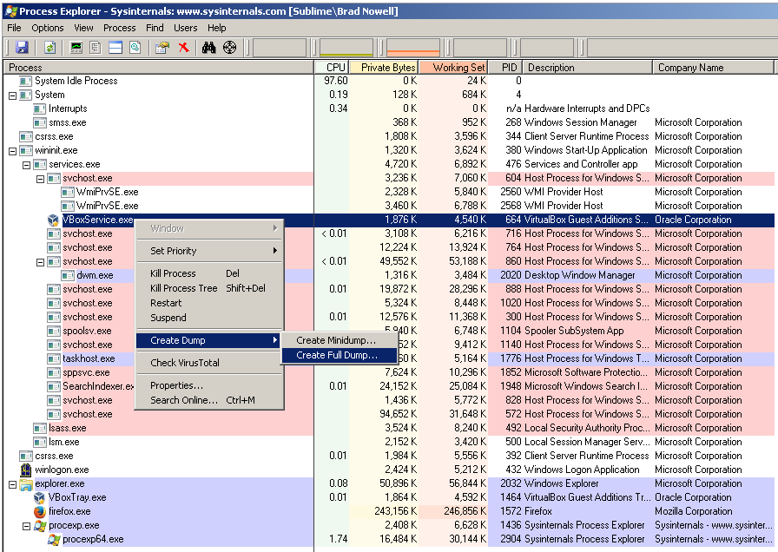
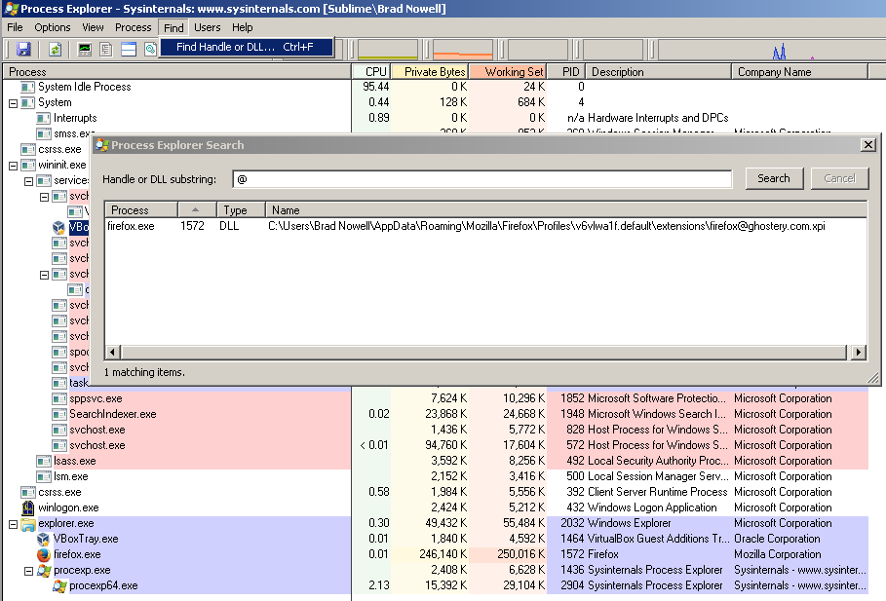
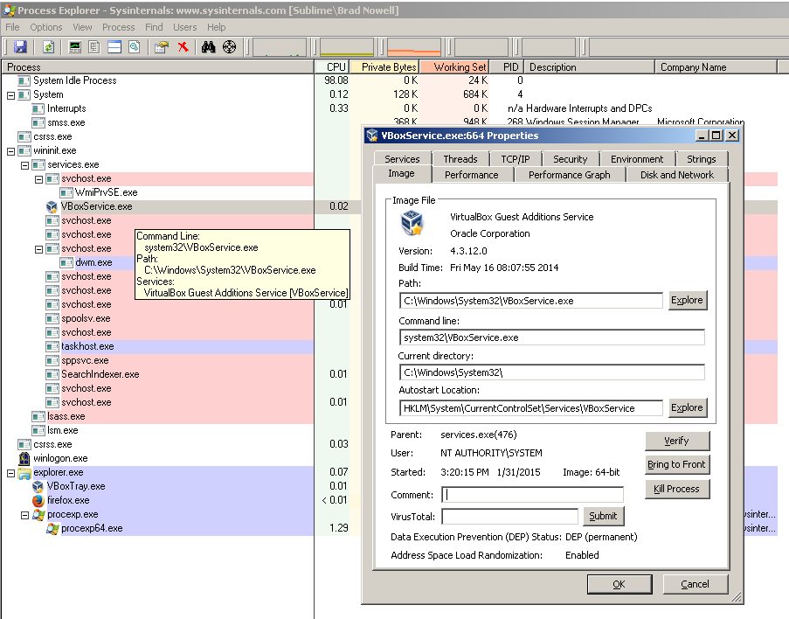
Tools of the Tirade
Find and Identify Malware – See the forest for the execution tree
Process Explorer
https://technet.microsoft.com/en-us/sysinternals/bb545021.aspx

Slide 10
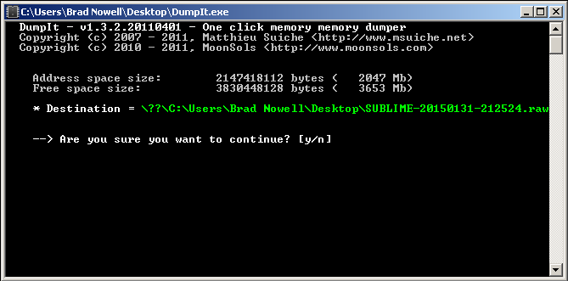
Tools of the Trade
Dump all the memory!!!!
DumpIt
http://www.moonsols.com/2011/07/18/moonsols-dumpit-goes-mainstream/

Slide 11
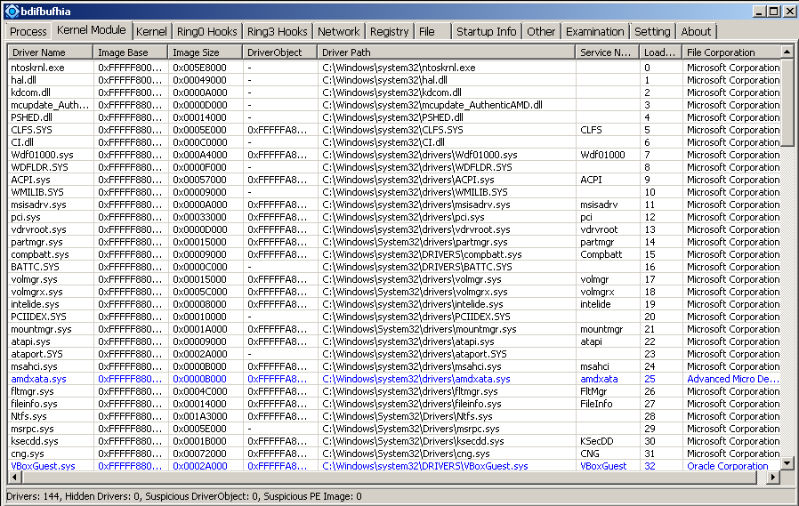
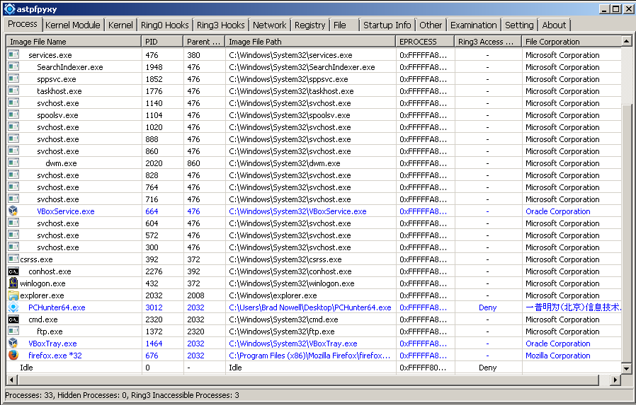
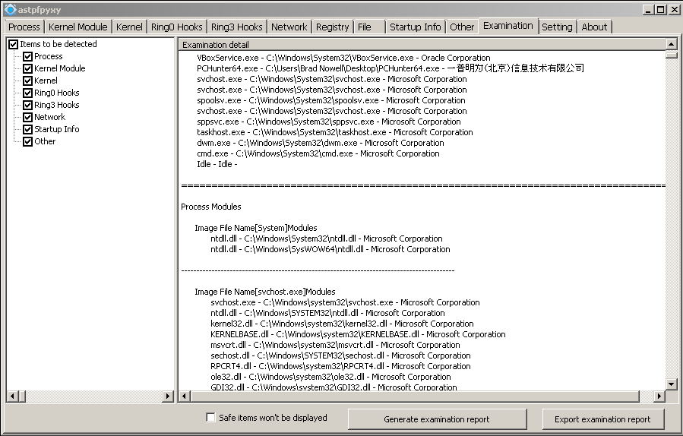
Tools of the Trade
Take a deeper look at the active system
PCHunter aka Xuetr
http://www.xuetr.com/download/

Slide 12



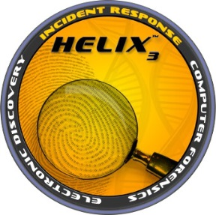






Tools of the Trade
Other post-infection tools and suites

Slide 13

Thank you!!!!
questions?
caleb@dirtywhitehat.net @dirtywhitehat

